Slide 1
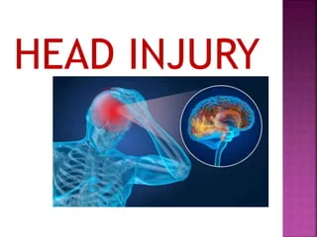
Head injury Traumatic Brain Injury
Dr/ Sanaa Saber Mohamed
Assistant Professor of Critical Care Nursing
2024

Slide 2
Outlines
Introduction
Definition
Pathophysiology
Etiology of head injury
Clinical Presentation
Assessing the Severity of traumatic brain injury
Diagnostic Tests
Management
Complication
Nursing care for patient with head injuries

Slide 3
Introduction:
Traumatic brain injury is a global problem that leads to morbidity and mortality particularly among young people, Includes any injury or trauma to the scalp, skull, or brain. A serious form of head injury is traumatic brain injury. Statistics regarding the occurrence of head injuries are incomplete because many victims die at the injury scene or because the condition is considered minor and health care services are not sought.

Slide 4
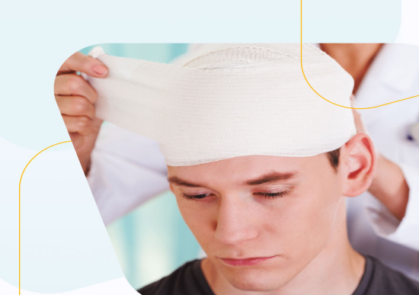
Definition:
Traumatic brain injury (TBI) is a nondegenerative, noncongenital insult to the brain from an external mechanical force, possibly leading to permanent or temporary impairment of cognitive, physical, and psychosocial functions, with an associated diminished or altered state of consciousness.
Traumatic brain injury refers to trauma to the scalp and skull that may or may not include injury to the brain.

Slide 5
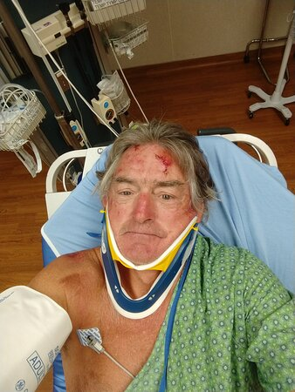
Damage to the brain from traumatic injury takes two forms:
1- Primary injury is the initial damage to the brain that results from the traumatic event. This may include contusions, lacerations, and torn blood vessels due to impact, acceleration/ deceleration, or foreign object penetration.

Slide 6
2- Secondary injury evolves over the ensuing hours and days after the initial injury and results from inadequate delivery of nutrients and oxygen to the cell.

Slide 7
Pathophysiology
Trauma → intracranial hemorrhage and hematoma → brain swelling → intracranial volume and ICP → displacement or herniation of the brain. Pressure on cerebral blood vessels → ↓ blood flow to brain → ↓ O2 to brain → cerebral hypoxia → cerebral ischemia, infarction, and irreversible brain damage → brain death.

Slide 8
Etiology of head injury:-

Slide 9
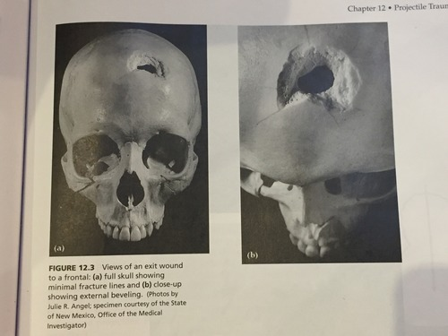
1- Blunt
• Motor vehicle collision
• Pedestrian event
• Fall
• Assault
• Sports injury
2- Penetrating
• Gunshot wound
• Arrow

Slide 10
Clinical Presentation

Slide 11
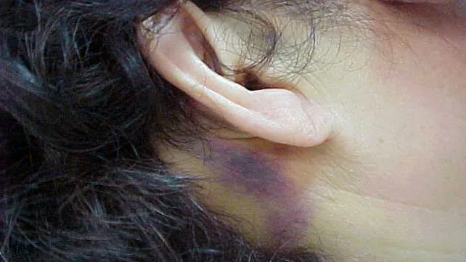
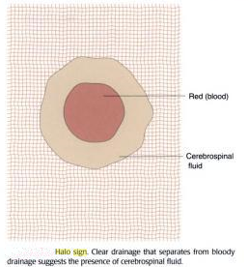
• Persistent, localized pain; headache.
• Loss of consciousness, confusion, drowsiness, personality change, Restlessness.
• Sudden onset of neurological deficits.
• Bruising over mastoid (Battle’s sign).
• Nausea and vomiting.
• CSF otorrhea (ears) or rhinorrhea (nose).
• Halo sign: Blood stain surrounded by a yellowish stain on bed linens or head dressing that may indicate CSF leak.
• Abnormal pupillary response.
• Altered or absent gag reflex.
• Absent corneal reflex.
• Change in vital signs: altered respiratory pattern, widened pulse pressure, bradycardia, or tachycardia.
• Seizures.

Slide 12
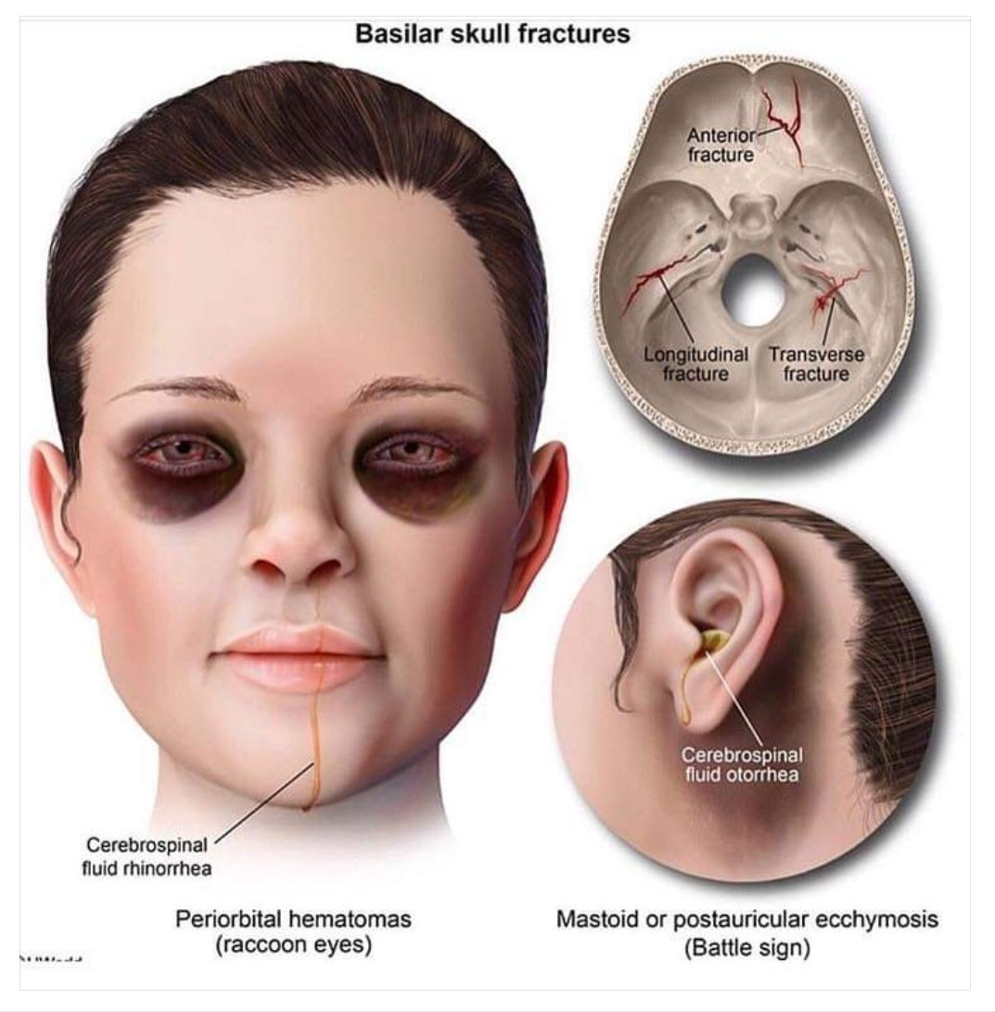

Slide 13
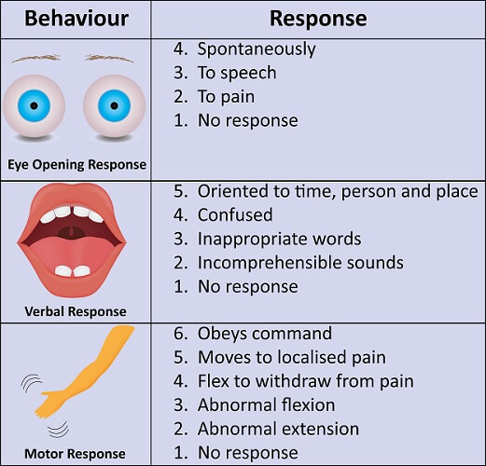
Assessing the Severity of traumatic brain injury
Glasgow Coma Scale (GCS): A 3- to 15-point scale used to assess a patient's level of consciousness and neurologic functioning, scoring is based on best motor response, best verbal response, and eye opening (eg, eyes open to pain, open to command)

Slide 14
• Duration of loss of consciousness: Classified as mild (mental status change or loss of consciousness [LOC] < 30 min), moderate (mental status change or LOC 30 min to 6 hr), or severe (mental status change or LOC >6 hr)
• Posttraumatic amnesia (PTA): The time elapsed from injury to the moment when patients can demonstrate continuous memory of what is happening around them.

Slide 16
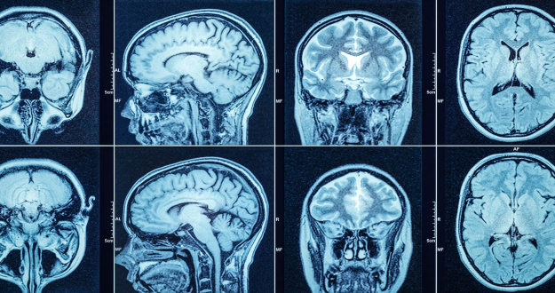
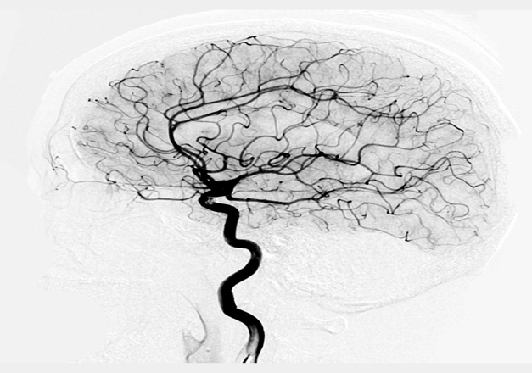
Diagnostic Tests
1- Check for cerebrospinal fluid leak.
2- X-ray, CT of the head, MRI, or PET to assess hematoma, swelling, and injury.
3- Cerebral angiography.
4- CBC, chemistry panel, and blood coagulation studies.
5- Urinalysis for specific gravity.

Slide 17
Management

Slide 18
1- Stabilize cardiac and respiratory function to ensure adequate cerebral perfusion. Maintain optimum ABGs or O2 saturation. Assess oxygenation and respiratory status.
2- Assess and monitor neurological status and ICP; calculate CPP to maintain >70 mm Hg.
3- Perform frequent neurological checks, including Glasgow Coma Scale.

Slide 19
4- Provide light sedation as necessary to ↓ agitation. Administer analgesics for pain. Induce barbiturate coma if necessary.
5- Administer hypertonic saline and osmotic diuretics as needed.
6- Monitor and control for elevations in ICP.
7- Induce therapeutic hypothermia.
8- Prepare patient for craniotomy to lessen the pressure in the brain if necessary.

Slide 20
9- Assess for vision and hearing impairment and sensory function.
10- Assess for hypothermia and hyperthermia. Control fever.
11- Institute seizure precautions. Minimize stimuli and excessive suctioning.
12- Monitor ECG for cardiac arrhythmias. Institute deep vein thrombosis.
13- (DVT) precautions.
14- Assess fluid and electrolyte balance. Control hemorrhage and hypovolemia.
15- Administer stool softeners to prevent Valsalva maneuver.
16- Keep head and neck in neutral alignment; no twisting or flexing of neck.
17- Keep head of bed elevated.
18- Maintain adequate nutrition orally or enterally. Assess and maintain skin integrity.
19- Provide DVT and peptic ulcer prophylaxis.

Slide 21
Complication:
1- Altered consciousness
2- Cerebrospinal fluid may build up in the spaces in the brain (cerebral ventricles) ----. Increase ICP and Hydrocephalus
3- Electrolyte imbalance.
4- Posttraumatic seizure disorder
5- Infection: Patient who on mechanical ventilation high risk for ventilator associated pneumonia catheter bloodstream, urinary tract infection, Meningitis.
6- Neurological deficits: cognitive, motor sensory, speech

Slide 22
Nursing care for patient with head injuries
A-nursing assessment:
• Airway: assess for vomitus, bleeding, and foreign objects. Ensure cervical spine immobilization.
• Breathing: assess for abnormally slow or shallow respirations. An elevated carbon dioxide partial pressure can worsen cerebral edema.
• Circulation: assess pulse and bleeding.
• Disability: assess the patient's neurologic status.

Slide 23
B-Nursing diagnosis:
• Altered Cerebral Tissue Perfusion related to increased ICP.
• Ineffective Breathing Pattern related to ↑ICP or brain stem injury.
• Altered Nutrition: Less Than Body Requirements related to compromised neurologic function and stress of injury.
• Altered Thought Processes related to physiology of injury.
• Risk for Injury related to altered thought processes.
• Ineffective Family Coping related to unpredictability of outcome.

